Slide 1
Introduction to Facebook Application Development
Leighton James
https://github.com/leightonj
https://twitter.com/leighton_j
http://www.facebook.com/leighton0102

Slide 2
What is a Facebook Application?
Application that allows integration with the Facebook platform
Multi-platform – Desktop: website, microsite on FB, mobile: mobile site, native application
Utilises Facebook Social Plugins, Social Channels and the Open Graph

Slide 3
Ingredients of a good social application
Rewarding for the users
Includes social plugins and connections to social channels for sharing your application
Simple and fun
Know your audience
Clear objectives
Mirror how users use Facebook – fun, photos, sharing
WITHIN FACEBOOK POLICY!

Slide 4
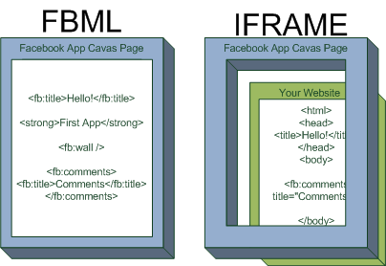
Application integration

Slide 5
Benefits of iFrame integration
Control own hosting
Use current code and skillsets
Now the ONLY way!

Slide 6

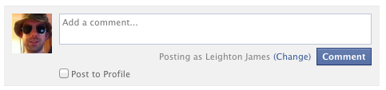

Facebook Social Plugins
http://developers.facebook.com/docs/plugins
Like The Like button lets users share pages from your site back to their Facebook profile with one click.
Send The Send button allows your users to easily send your content to their friends.
Comments The Comments plugin lets users comment on any piece of content on your site.
Activity Feed The Activity Feed plugin shows users what their friends are doing on your site through likes and comments.
Login The Login Button shows profile pictures of the user's friends who have already signed up for your site in addition to a login button.

Slide 7
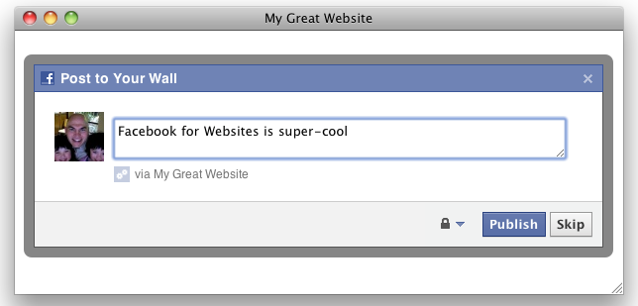
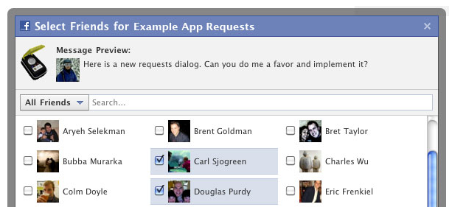
Facebook Social Channels
http://developers.facebook.com/docs/channels/
News Feed The News Feed is shown immediately to users upon logging into Facebook. Recommended way to publish to is with the Feed Dialog
Requests Requests are a great way to enable users to invite their friends to use your app

Slide 8
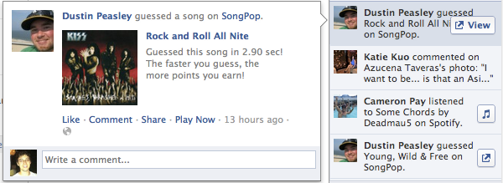
Open Graph
An extension of the social graph - people and the connections they have to everything they care about. e.g. Leighton likes Radiohead
Recently been updated to allow custom actions against objects e.g. Leighton is listening to Radiohead
User's actions on objects are published in the ticker on the user's homepage.
Custom actions can be published via an app without the need for a dialogue, requiring the publish_actions permission on app authentication.

Slide 9
Useful Links
http://developers.facebook.com/
http://developers.facebook.com/docs/coreconcepts/
http://developers.facebook.com/tools/debug
http://developers.facebook.com/tools/explorer/
http://developers.facebook.com/roadmap/
https://www.facebook.com/dialog/pagetab?app_id=[app_id]&next=[url]
http://developers.facebook.com/policy/

Slide 10
Some Facebook Jargon
Canvas Application
A Facebook application that is not run from within a fanpage, but instead from a URL on apps.facebook.com
For example:
Can have fluid width, or fixed at 760px
Can have fluid height of fixed to any whole number of pixels.
URL suffix passed through directly
http://apps.facebook.com/soundcloud/
Tab Application
A Facebook application that is run from within a fanpage.
Fixed width at 810px
Can have fluid height or fixed to any whole number of pixels.
Only ‘appdata’ querystring variable passed through
http://www.facebook.com/cocacola/app_414055015274304
Tile
A widget that is accessible at the top of a Facebook fanpage.
URLs for tile applications take the form: http://www.facebook.com/BigBrotherUK/app_180572305343692
Tile applications are run from within the fanpage, allowing user access to other fanpage features.
Can have narrow width (520px) or wide width (810px)
Can have fluid height.

Slide 11
Sandbox mode
This is a mode of a Facebook application that is enabled before the campaign is launched
Only selected Facebook profiles will be able to access the application, receive application alerts, and view wall posts created by the application.
Sandbox mode does not stop direct access to the project via its hosted URL, it is merely a means to control visibility of the applications interaction with Facebook.
Application Permissions
Gives the application permission to access and interact with the user’s Facebook profile
Basic permissions are required as a minimum (ID, Name, picture, gender, locale)
Signed Request
This is an encoded string passed from Facebook to pass data to an application.
An application would typically use this string to retrieve use, visit information and an access token
Access Token
This is a token given by Facebook that enables the app to make requests to Facebook's API for entities such as a Facebook User or Fanpage.
These can become invalid by expiring, user changing their password or a user de-authorising the application.

